Slide 1
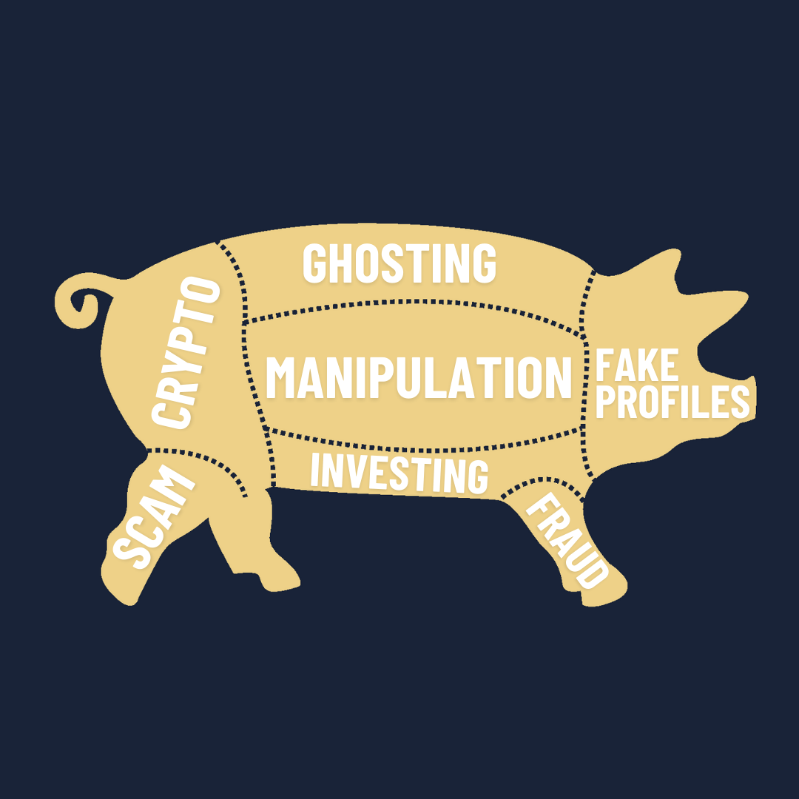
Scam Butchering
By: Ambrish, Rukie, Ambi, Cara-Ann, Himal, Bilal

Slide 2
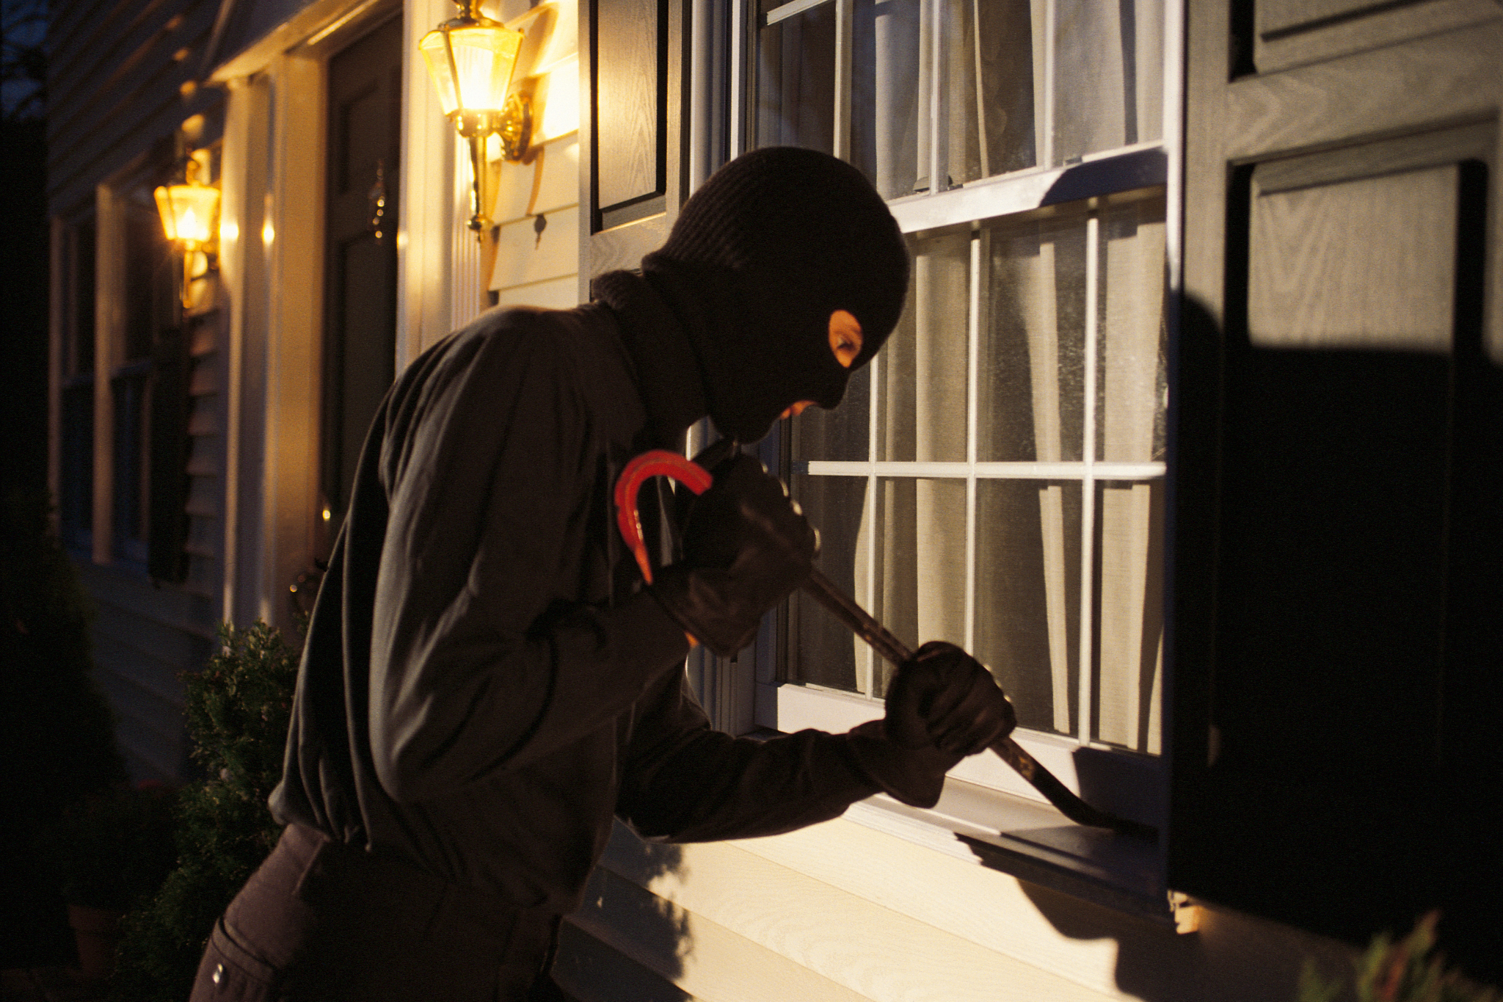

Slide 3

Romance Fraud
Financial losses : Victims lose $1 billion worldwide
Emotional impact : leaves victims devastated
(Cross, 2023b; Wiederhold, B. K., 2024).

Slide 4

Existing Prevention Measures
Victim only education methods are NOT effective
Disproportionately focuses on older female adults - WRONG TARGET GROUP!
Men aged 30-40 years old (target audience)
(Drew & Webster, 2024)

Slide 5
DEMO

Slide 6

Legal Obligations
Privacy Act 1988 (Cth)
Scam Prevention Framework Act (Cth)
Lowering burden on meta (Facebook, Instagram, WhatsApp)

Slide 7



Our product - Cu3Secure
Information from scam-baiters
Cost -effective
Open-Source data

Slide 8

Solution: Cu3Secure
Notes:
https://www.reddit.com/r/scambait/comments/1fo0zmr/another_scammer_broke_my_heart/#lightbox

Slide 9
